Slide 1

Normalization

Slide 2
Agenda
Physical Modeling and Normalization
Database Anomalies
Functional Dependency
Normal Forms
1NF, 2NF, 3NF
BCNF (concept)
Demoralization (concept)

Slide 3
What is Normalization?
Normalization is a process of analyzing a relation to ensure it is well formed
More specifically, if a relation is normalized, rows can be added, removed, or updated without creating exceptions

Slide 4
Normalization
The process of decomposing relations with anomalies to produce smaller well-structured relations.
Anomalies: Errors or inconsistencies that may result when user attempts to update a table that contains redundant data.
Well-structured relations contains minimal redundancy and allows users to insert, modify, and delete the rows in a table without errors or inconsistencies.
Notes:
Normalization is the process for assigning attributes to entities. Normalization reduces data redundancies and by extension helps eliminate the data anomalies that result from those redundancies.

Slide 5
Well-structured relations :
A well-structured relation contains minimal redundancy and allows users to insert, modify and delete the rows in a table without errors and inconsistencies
Redundancies in a table (such as more than one entry for each EMPLOYEE) may result in errors and inconsistencies (anomalies) when the table is updated
3 Types of anomaly are possible, insertion, deletion and modification anomalies

Slide 6
Anomalies
Relations that are not normalized will experience issues known as anomalies
Insertion anomaly
Difficulties inserting data into a relation
Modification anomaly
Difficulties modifying data into a relation
Deletion anomaly
Difficulties deleting data from a relation
Notes:
Insertion Anamoly
Suppose the data of an employee has to be deleted then the data that the employee had completed a course on some date will be lost.
This information may of importance to the training department.
Deletion Anamoly
Suppose the data of an employee has to be deleted then the data that the employee had completed a course on some date will be lost.
This information may of importance to the training department.
Updation Anamoly
Suppose an employee gets an increase in salary and has done many courses, the increase must be recorded in each of the rows for the employee, otherwise, the data will be inconsistent.

Slide 7
Insertion anomaly
Insertion anomaly – looking at EMPLOYEE2:
A1 Fred Bloggs Info Sys Delphi
A1 Fred Bloggs Info Sys VB
Suppose that we want to add a new employee – the primary key for this relation is the combination of Emp_ID and Course_Title. Therefore, to insert a new row, the user must supply both these values (since primary keys cannot be null or nonexistent)
This is an anomaly, since the user should be able to enter employee data without supplying course data

Slide 8
Deletion and Modification anomalies
Suppose that the data for a particular employee are deleted from the table
This results in losing the information that this employee completed a particular course
This results in losing the information that this course was offered – deletion anomaly
If employee A1 changes the department they work in, this must be recorded in both the rows of the table otherwise the data will be inconsistent – modification anomaly

Slide 9
Functional Dependencies And Keys
Normalization is based on the analysis of functional dependencies.
Functional dependency A constraint between two attributes or two sets of attributes.
Emp_ID, Course_Name Date_Completed
The date a course is completed is determined by the identity of the employee and the name of the course.

Slide 10
Stages of Normal Forms
First Normal Form (1NF)
Second Normal Form (2NF)
Third Normal Form (3NF)
Boyce-Codd Normal Form (BCNF)
Fourth Normal Form (4NF)
Fifth Normal Form (5NF)
Domain/Key Normal Form (DK/NF)

Slide 11
First Normal Form
A relation is in first normal form when it contains no multi-valued attributes.
The value at the intersection of each row and column must be atomic.
Notes:
The term first normal form (1NF) describes the tabular format in which
All the key attributes are defined
There are no repeating groups in the table. In other words , each row/column intersection can contain on and only one value, rather than a set of values.
All attributes are dependent on the primary key

Slide 12
TABLE WITH REPEATING GROUPS
EMPLOYEE - Data base
Emp_ID | Name | Dept_Name | Salary | Course_Name | Date_Completed
1233 | Andrew | Market | 48,000 | SSAD MS-Office | 06/12/1999 12/05/1998
1245 | James | Accounting | 52,000 | Taxation | 09/07/1998
1456 | Mary | MIS | 80,000 | C++ D2000 Java Basics | 03/03/2000 12/01/1998 14/06/1999
1789 | Robert | MIS | 90,000 | DB2 CICS SSAD | 03/03/1998 29/10/1999 15/05/1999

Slide 13
TABLE IN FIRST NORMAL FORM
EMPLOYEE - Data base
Emp_ID | Name | Dept_Name | Salary | Course_Name | Date_Completed
1233 | Andrew | Marketing | 48,000 | SSAD | 06/12/1999
1233 | Andrew | Marketing | 48,000 | MS-Office | 12/05/1998
1245 | James | Accounting | 52,000 | Taxation | 09/07/1998
1456 | Mary | MIS | 80,000 | C++ | 03/03/2000
1456 | Mary | MIS | 80,000 | D2000 | 12/01/1998
1456 | Mary | MIS | 80,000 | Java Basics | 14/06/1999

Slide 14
Project Data base
TABLE WITH EMPTY FIELDS
Proj_Num | Proj_Name | Emp_num | Emp_ Name | Job_Class | Chg_Hour | Hrs
15 | Evergreen | 103 | June E Arbough | Elec_Engineer | $84.50 | 23.8
 |  | 101 | John G News | Database Designer | $105.00 | 19.4
 |  | 105 | Alice K Johnson | Database Designer | $105.00 | 35.7

Slide 15
Project Database
TABLE IN FIRST NORMAL FORM
Proj_Num | Proj_Name | Emp_num | Emp_Name | Job_Class | Chg_hour | Hrs
15 | Evergreen | 103 | June E Arbough | Elec_Engineer | $84.50 | 23.8
15 | Evergreen | 101 | John G News | Database Designer | $105.00 | 19.4
15 | Evergreen | 105 | Alice K Johnson | Database Designer | $105.00 | 35.7
Data Organization : First Normal Form
Notes:
After applying first normal form.

Slide 16
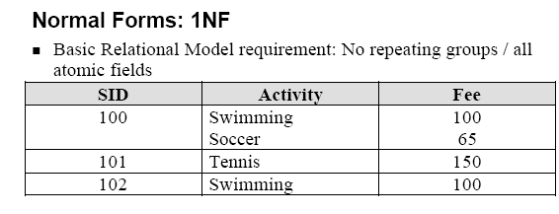
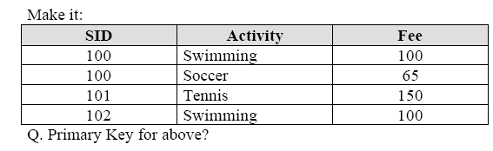
Example for 1NF

Slide 17
Second Normal Form
A relation that is in first normal form and has every non-key attribute functionally dependent on the primary key.
A relation that is in first normal form is in second normal form if and only if
The primary key consists of only one attribute.
No non-key attribute exists in the relation.
Every no-key attribute is functionally dependent on the primary key.
To convert relation into second normal form, we decompose the relation into new relationships.

Slide 18
Second Normal Form
EMPLOYEE is decomposed into two relations
EMPLOYE1
Emp_ID | Name | Dept_Name | Salary
1233 | Andrew | Marketing | 48,000
1245 | James | Accounting | 52,000
1456 | Mary | MIS | 80,000
EMPLOYE2
Emp_ID | Course_Name | Date_Completed
1233 | SSAD | 06/12/1999
1233 | MS-Office | 12/05/1998
1456 | C++ | 03/03/2000
1456 | D2000 | 12/01/1998
1456 | Java Basics | 14/06/1999

Slide 19
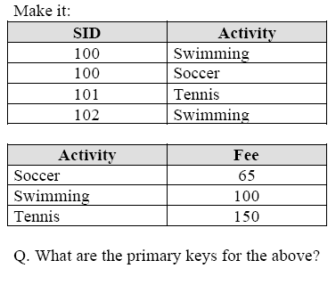
After applying 2NF

Slide 20
Third Normal Form
Transitive dependency
Functional dependency between two nor more non-key attributes.
A relation is in third normal form (3NF), if it is in second normal form and no transitive dependencies exist.

Slide 21
Third Normal Form
Relation with transitive dependency
SALES
CustID | Name | Salesperson | Region
Cust_ID is the primary key. All of the remaining attributes are functionally dependent on this attribute
However, region is functionally dependent on sales person and salesperson is functionally dependent on Cust_ID.

Slide 22
Third Normal Form
CustID | Name | Region
After applying Third Normal Form, Removal of Transitive Dependency
Salesperson | Region

Slide 23
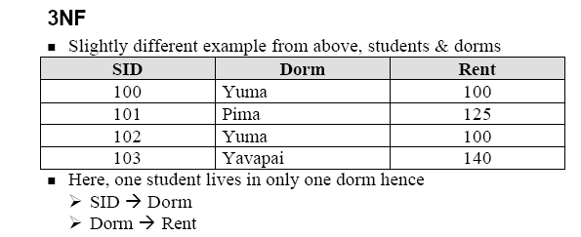

Example for 3NF

Slide 24
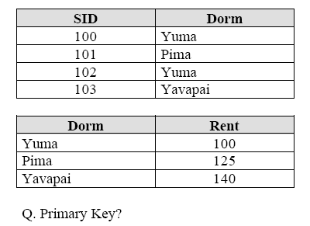
Solution to Previous Example

Slide 25
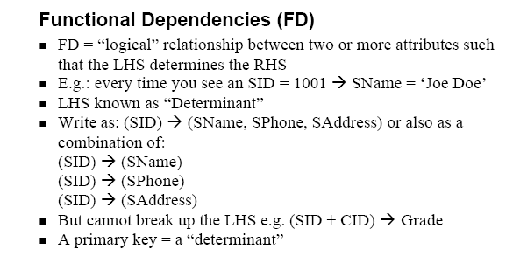

Slide 26
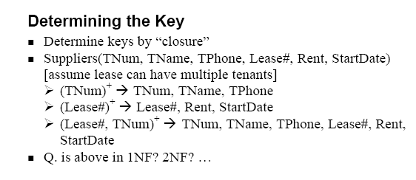

Slide 27
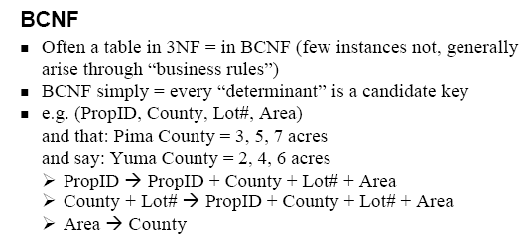
Boyce/Codd Normal form
Boyce / Codd normal form Any remaining anomalies that result from functional dependencies have been removed
Notes:
A table is in 2NF if:
It is in 1NF
It includes no partial dependencies; that is , no attribute is dependent on only a portion of the primary key.
A table is in 3NF if :
It is in 2 NF
It contains no transitive dependencies

Slide 28
Denormalization
Normalization leads to distribution of data across multiple tables, resulting in multiple joins whenever you need to present all the data in one integrated view
Joins result in performance degradation and slow processing as the data grows
Denormalization is a technique by which data from frequently joined tables is pulled together into a single table so that users who need integrated view of data can directly query it from this table instead of using joins
Thus denormalization helps in improving performance, especially where fast processing and retrieval of data is required

Slide 29
Thank you
Visit us at www.techmahindra.com
Disclaimer
Tech Mahindra Limited, herein referred to as TechM provide a wide array of presentations and reports, with the contributions of various professionals. These presentations and reports are for informational purposes and private circulation only and do not constitute an offer to buy or sell any securities mentioned therein. They do not purport to be a complete description of the markets conditions or developments referred to in the material. While utmost care has been taken in preparing the above, we claim no responsibility for their accuracy. We shall not be liable for any direct or indirect losses arising from the use thereof and the viewers are requested to use the information contained herein at their own risk. These presentations and reports should not be reproduced, re-circulated, published in any media, website or otherwise, in any form or manner, in part or as a whole, without the express consent in writing of TechM or its subsidiaries. Any unauthorized use, disclosure or public dissemination of information contained herein is prohibited. Unless specifically noted, TechM is not responsible for the content of these presentations and/or the opinions of the presenters. Individual situations and local practices and standards may vary, so viewers and others utilizing information contained within a presentation are free to adopt differing standards and approaches as they see fit. You may not repackage or sell the presentation. Products and names mentioned in materials or presentations are the property of their respective owners and the mention of them does not constitute an endorsement by TechM. Information contained in a presentation hosted or promoted by TechM is provided “as is” without warranty of any kind, either expressed or implied, including any warranty of merchantability or fitness for a particular purpose. TechM assumes no liability or responsibility for the contents of a presentation or the opinions expressed by the presenters. All expressions of opinion are subject to change without notice.

